Slide 1

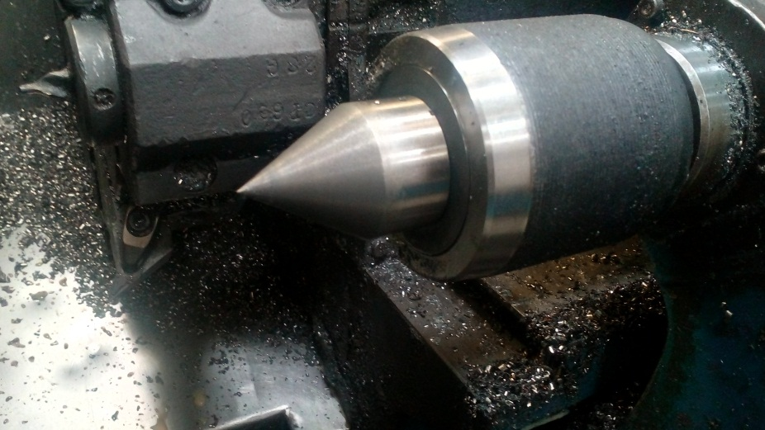
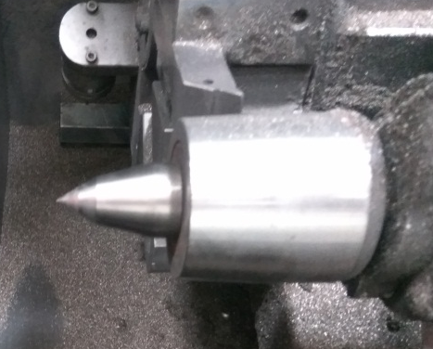
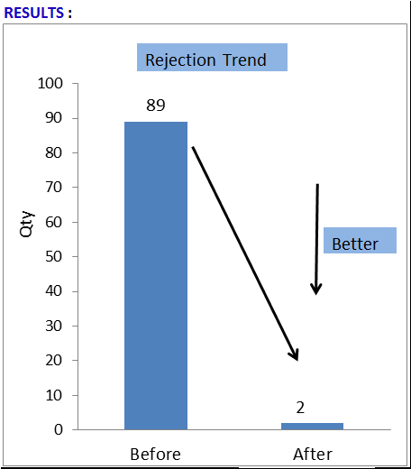
P15
TPM CIRCLE NO :- 01
ACTIVITY
KK
QM
PM
JH
SHE
OT
DM
E&T
KAIZEN IDEA SHEET
TPM CIRCLE NAME: Achiever
LOSS NO. / STEP
DEPT :- MACHINE SHOP
RESULT AREA
P
Q
A
C
D
S
M
B
CELL:- Drum Change
CELL NAME:- A189 DC
MACHINE / STAGE :- MAZAK
OPERATION :- HPT
KAIZEN THEME : To eliminate A189 drum change Dia. 16.00 mm undersize
IDEA :- High speed revolving center provided
PROBLEM PRESENT STATUS :- A189 drum change Dia. 16.00 mm undersize
COUNTERMEASURE:-
1. High speed revolving center to be provided
BENCHMARK
89 No's
TARGET
0 no
KAIZEN START
07.02.2017
TDC
02.03.2017
KAIZEN FINISH
TEAM MEMBERS :, Santosh
Wakchaure, someshwar Salunkhe
BENEFITS :-
Eliminate customer complaint .
Eliminate in house rejection.
High speed revolving center
Low speed revolving center
KAIZEN SUSTENANCE
Before
After
WHY - WHY ANALYSIS :-
Why1 :- A189 Drum Change Dia. 16.00 mm
undersize
Why2 :- During HPT excess material remove on Dia.
16.00 mm
Why3 :- Chuck speed ( Dia. 32.00 mm side 3000
rpm) & Tail stock revolving speed not
match( Dia. 16.00 mm side)
Why4 :- low speed revolving center used
RESULT :-
WHAT TO DO:- Check point added in Sustenance audit check sheet.
HOW TO DO:- Check visually.
FREQUENCY :- Daily
SCOPE & PLAN FOR HORIZONTAL DEPLOYMENT
Sr No | CELL | TDC | RESP. | STATUS
1 | NA | NA | NA | NA
2
ROOT CAUSE : low speed revolving center used
REGISTRATION NO. & DATE : 07.02.2017
REGISTERED BY :- Sachin Kadnar
MANAGER’S SIGN :- Sandeep Patil

